Slide 1
DBMS Mini Project
Recipe RECOMMENDATION System
Team Members:
Manasa H K(1RVU23CSE252)
P K Shreya(1RVU23CSE335)
Spoorti Y M(1RVU23CSE467)
Course Lead:
Prof. Ashwini Kumar Mathur

Slide 2
AGENDA
INTRODUCTION 3
PROBLEM STATEMENT 4
ER DIAGRAM 5
PROJECT REQUIREMENT AND IMPLEMENTATION 6
CONCLUSION 11

Slide 3
Introduction: The Recipe Recommendation System is a web-based application designed to provide users with personalized recipe suggestions based on the ingredients they have available. The system aims to simplify meal planning by recommending recipes that match the ingredients the user inputs, enhancing cooking convenience and reducing food waste. Key features of the system: User Profiles: Users can create and manage their profiles, storing their preferences and browsing history. Recipe Recommendations: The system suggests recipes based on available ingredients and user preferences. Admin Dashboard: The admin can manage users, recipes, and reviews. Interactive Recipe Details: Each recipe includes a list of ingredients, steps, cooking time, and serving size for easy preparation. This project incorporates both frontend and backend technologies to offer an efficient and user-friendly experience for both admins and users.

Slide 4
Problem Statement:
In today's fast-paced world, planning meals can be a time-consuming and often challenging task. People often struggle with deciding what to cook based on the ingredients they have on hand, leading to food waste or last-minute meal decisions.
The challenge is further compounded for individuals with limited cooking experience or those who need help in creating balanced meals with available ingredients.
The Recipe Recommendation System seeks to solve the following problems:
Ingredient Utilization: Recommending recipes based on the ingredients a user already has, reducing food waste.
Time and Effort Efficiency: Helping users save time by suggesting quick and easy recipes based on their preferences and available ingredients.
User Experience: Offering a user-friendly interface for both regular users and admins to manage and explore recipes effectively.
The goal of this project is to provide an efficient and intuitive way for users to discover recipes, manage meal plans, and make the most of their available ingredients
4

Slide 5
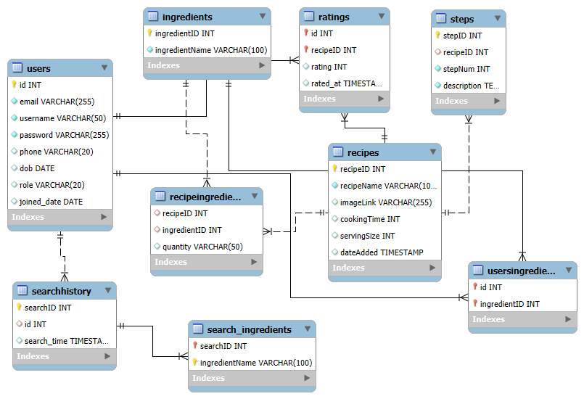
ER diagram:

Slide 6
Project Requirements: The Recipe Recommendation System requires a combination of functional and non-functional components to ensure its smooth operation and user satisfaction. Below are the key requirements: Functional Requirements: 1. User Registration and Login: →Users can register and log in using their email and password. →Admin users have access to additional features, including managing users and recipes. 2. Recipe Management: →Admins can add, edit, delete, and view recipes. →Recipes must include details like name, image, cooking time, serving size, and ingredients. 3. Recipe Recommendation: →Users can enter available ingredients and receive recipe suggestions based on their inputs. →The system should match ingredients with recipes and suggest appropriate cooking instructions. 4. Profile Management: →Users can view and edit their profiles, including their personal details (name, phone, email, etc.). 5. Search History: →Users’ search histories are stored, allowing them to revisit previously searched recipes

Slide 7
Non-Functional Requirements: User Interface (UI): →A simple, intuitive, and responsive UI to ensure a seamless experience on both desktop and mobile devices. Database Integration: →A well-structured database for storing users, recipes, ingredients, and steps, ensuring efficient queries and updates. Performance: →The system should handle multiple users and recipe searches efficiently with minimal delays. Security: →Proper security measures like password encryption, session management, and role-based access control for admin and regular users. Scalability: →The system should be scalable to allow for the easy addition of more recipes, users, and ingredients without significant changes to the underlying architecture.

Slide 8
Implementation: The Recipe Recommendation System is developed using a combination of technologies and follows a structured approach for its implementation: 1. Frontend Development: HTML/CSS: →Used for creating responsive and visually appealing pages for users and admins. →Layouts include forms for recipe input, profile editing, and search options for recommendations. JavaScript: →Provides dynamic features, such as displaying recipe suggestions in real-time based on user input (ingredients), and handling form submissions asynchronously. 2. Backend Development: Flask Framework (Python): →Lightweight framework used to build the web application. →Handles HTTP requests for viewing, adding, editing, and deleting recipes and ingredients. →Manages user authentication, profile updates, and role-based access (admin/user). Flask-Mysql.Connecter: →ORM for database interaction, simplifying the management of complex queries and database operations. Used for creating and managing tables for Users, Recipes, Ingredients, and Steps.

Slide 9
3. Database: MySQL Database: →Stores user data, recipes, ingredients, and cooking steps. →Relationships between tables (Recipes, Ingredients, and Users) are set up using foreign keys. →Structured queries are used to retrieve recipes based on the user’s available ingredients. 4. Recipe Recommendation Algorithm: Ingredient Matching: →When a user enters available ingredients, the system queries the database for recipes containing those ingredients. →Recipes are filtered and ranked based on the ingredients provided by the user. Flexible Matching: →Supports partial ingredient matches, so users are given recipes even if they have a limited number of ingredients available. 5. Admin Dashboard: Admin Controls: →Allows admins to manage users (view, delete) and recipes (add, edit, delete). Provides admin-only access to sensitive functions like user management.

Slide 10
6. Session Management and User Authentication: Flask-Login: →Manages user sessions, ensuring that users are logged in before they can access personalized features like saving recipes and profile updates. Role-Based Access Control: →Users and admins are given specific permissions based on their roles. Admins can modify recipes and manage users, while regular users can only search, view, and edit their profiles. 7. Error Handling and Security: Error Handling: →Ensures the application gracefully handles database errors, invalid user input, and network issues. Security: →Passwords are hashed using SHA-256 for security. CSRF protection and other security features are integrated to ensure safe user interactions.

Slide 11
Conclusion:
The Recipe Recommendation System successfully integrates a user-friendly interface with powerful backend features to provide personalized recipe suggestions based on the ingredients users have on hand. The key takeaways from the project are:
1. Efficient Recipe Matching:
The system efficiently matches user-provided ingredients with available recipes, offering relevant recommendations, even with partial ingredient inputs.
2. User-Centric Design:
Both the admin and user dashboards are designed to be intuitive and easy to navigate, making it simple for users to find recipes and for admins to manage the system.
3. Scalable Architecture:
The use of Flask and MySQL allows the system to scale effectively, with the flexibility to add more features, such as user reviews or ingredient categories.
4. Role-Based Access:
The implementation of role-based access ensures secure management of data, allowing admins to control recipe and user information while providing users with a personalized experience.

Slide 12
5. Future Enhancements:
Future versions of the system can include:
Integration with external recipe APIs for a larger recipe database.
Enhanced recommendation algorithms, incorporating dietary preferences, cooking difficulty, and ratings.
A mobile app version for better user accessibility and engagement.
6. Learning Outcomes:
Through this project, we have gained practical experience in full-stack web development, database management, and building an intelligent recommendation system based on user input.
THANK YOU

